Slide 1
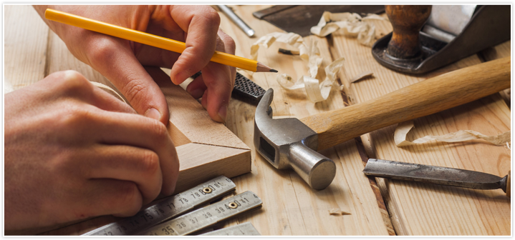
higher Design & Manufacture
An introduction to wood

Slide 2
Learning intentions & success criteria
Learning Intentions
To develop an understanding of the properties and uses of wood in everyday objects.
Success Criteria
I can name 5 commonly used woods.
Give examples of properties that relate to these woods

Slide 3
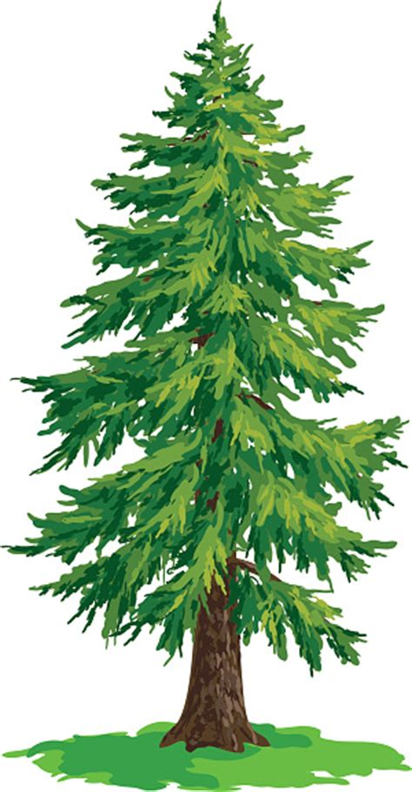
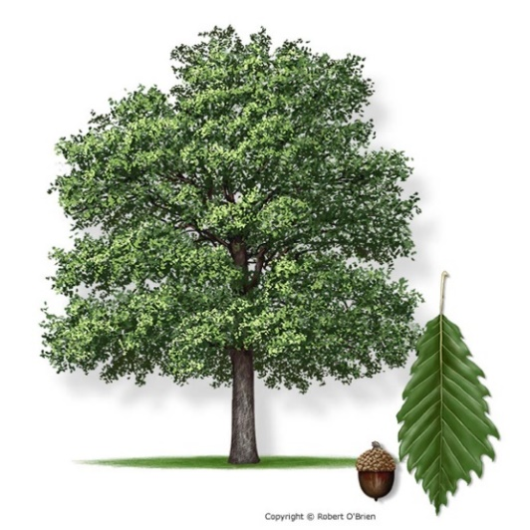
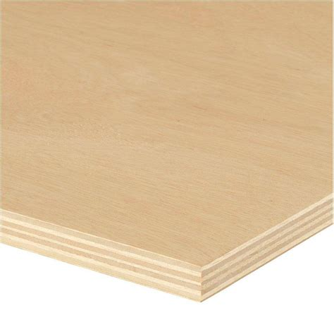
wood
Wood is an extremely useful natural material. There are three classifications of wood to be considered:
Hardwoods – slow growing (100 years) from warmer climates
Softwoods – quick growing (30 years)
Manufactured Boards – man-made composites

Slide 4
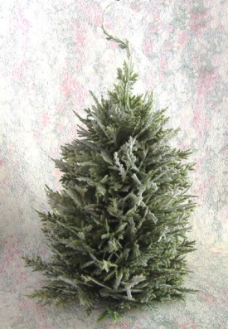
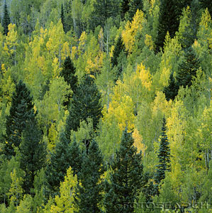
wood
The terms Hardwood and Softwood refer to the way in which the trees grow NOT to how hard the wood is to work with, for example, Balsa:
Balsa is a hardwood which is lightweight and easy to work with
Pine is a softwood which is heavy and very difficult to work.
Hardwood comes from broad leaved trees which are usually deciduous but can also be evergreen.
Softwood comes from coniferous trees most of which are evergreen with thin needle like leaves.

Slide 5
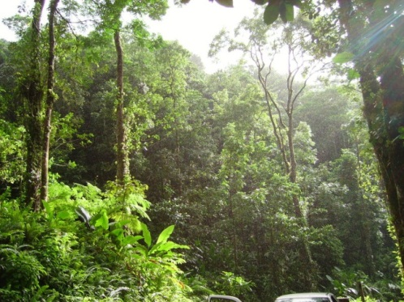
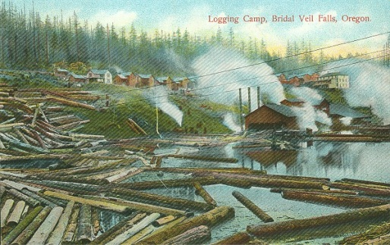
wood
Each species of tree provides a different timber.
Timber will vary in
Colour
Grain pattern
Texture
Strength weight
Stability
Durability
Ease of working and cost
Trees are converted to usable timber by logging, sawing and seasoning (air or kiln etc. and treating with oil/stains).
Unseasoned wood will warp, twist and will eventually split.

Slide 6
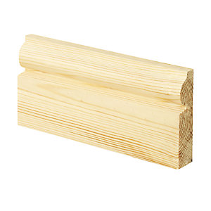
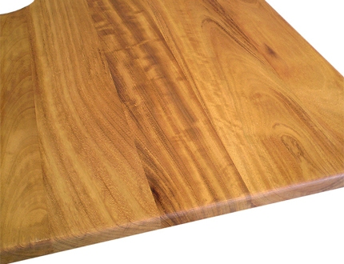
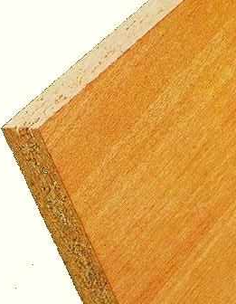
Natural and manufactured woods
Natural timber is generally sold as planks or boards. These planks can be planed (smooth) or un-planed (rough).
Natural timber also comes in;
Strips
Squares
A variety of specialist mouldings.
Manufactured Boards are usually only available in large flat sheets.
Strong
Stable
Economical.
Suited to the mass production of e.g. furniture
Cheap
Come in large widths.
Ecologically they can be seen as being beneficial as they use the waste products from the sawmill to make up particle and fibreboard.

Slide 7
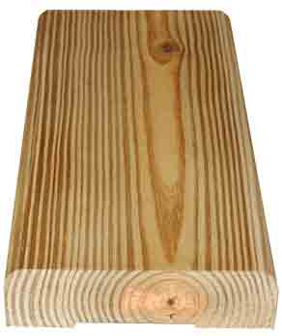
softwoods
Softwood trees tend to grow in areas which have:
cold climates or
high altitudes.
Softwoods are relatively cheap and are also easier to sustain by replanting as they grow quickly.
Softwoods can be easily identified by their open grain pattern and light colour - a straighter grain will give a stronger timber which, if knot free, is easier to cut and shape.
Knots are created where branches join the tree. Softwood trees can be made to grow knotless and straight grained by growing them closer together. Side branches are discouraged by lack of space and sunlight, selective felling of these trees allows them to grow in girth and height.

Slide 8
softwoods
Advantages of using softwoods are:
Inexpensive
Widely available
Easy to cut and shape
Grow quickly meaning they can be easily obtained/sourced
Disadvantages of using softwoods are:
Prone to warping
Can feature lots of knots

Slide 9
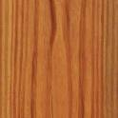
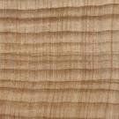
Name | Properties | Uses | Cost
Red Pine | Straight grained, but knotty, quite strong and easy to work. Red/orange in colour | Building construction. Needs good protection when used outside. | Low
Parana Pine | Straight grained with few knots. Quite strong and durable but warps easily. | High quality interior construction and furniture. | High
Spruce (whitewood) | Quite strong with few knots. Resistant to splitting but not durable. | Fitted furniture e.g. Kitchen cabinets. | Low
Cedar | Straight grained and knot free. Very light and durable. Quite soft | Shed construction and good quality fencing. | High

Slide 10
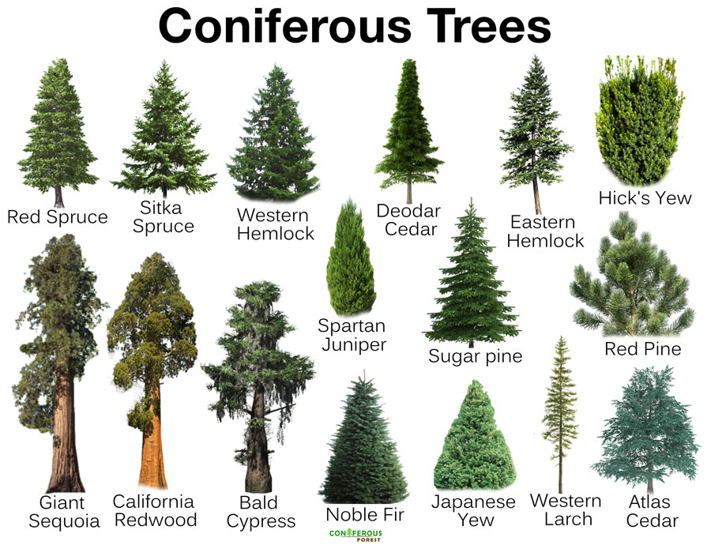

Slide 11
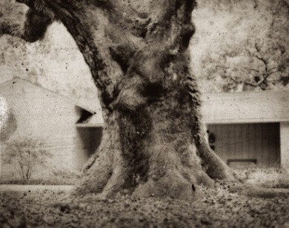
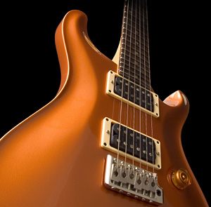
hardwoods
Hardwoods are grown in regions with warm temperatures such as tropical climates. Hardwood tree growth is generally slow making this type of wood expensive.
Tropical hardwoods grow more quickly and to a greater size but their use has been heavily criticised by environmentalists because it contributes to the problems of deforestation.
Forests that are not replanted are lost for all time affecting the atmosphere, soil erosion, rivers etc.
Hardwoods generally have more;
Attractive grain structures
Textures
Colours
Durability than softwoods.

Slide 12
hardwoods
Advantages of using hardwoods are:
Durable / Hardwearing
Aesthetically pleasing
Disadvantages of using hardwoods are:
More expensive than softwoods
Grow slowly so not as widely available as softwoods
Often obtained from rainforests.

Slide 13
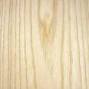
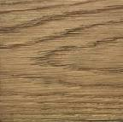
Name | Properties | Uses | Cost
Ash | Light in colour, flexible, tough bends well and varnishes well. | Tool handles, cricket/baseball bats, snooker cues, ladders and veneers. | Med
Beech | Mid-brown colour, hard, strong, tough, tends to warp but bends well. | High quality furniture, toys, tool handles and veneers. | Med
Oak | Light brown, hard, tough, heavy and durable outside. Gets harder with age. | high quality furniture, garden furniture, boats and veneers. | High
Mahogany | Red in colour, medium weight, quite strong, durable but warps easily. | high quality furniture, shop furniture, boat fittings and veneers. | High

Slide 15
Manufactured boards
Manufactured boards are composites that are known as laminated particle and fibreboards.
Generally, these materials are manufactured using layers or fibres of natural timber which are formed into thin sheets or particles and then bonded with resin before being compressed and heated.
Advantages:
Cheap
Stable (they don’t warp or twist)
Expensive timbers can be used to create decorative veneers
Boards are available in large sheets
Disadvantages
Edges require facings
Repair and maintenance can be difficult
Not as aesthetically pleasing as natural woods

Slide 16
plywood
An engineered sheet timber comprised of three or more thin layers of wood veneer (plies) that are glued together to form a thicker, flat sheet.
The plies are glued together at 90° to each other.
Plywood is a very versatile product, used for a range of structural, interior and exterior applications.

Slide 17
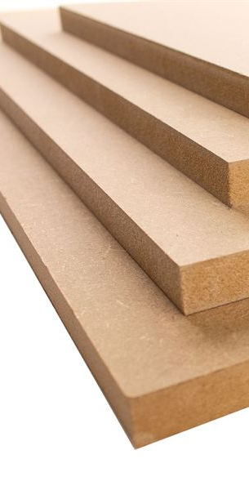
MDF
MDF stands for medium-density fiberboard.
It is manufactured from broken down hardwood and softwood into fibres and combined together with a wax or rein to form panels.
This is achieved by combining the fibres and resin at high pressure and temperature.
MDF is commonly used for furniture, flooring, cabinetry, fire resistance, soundproofing etc.

Slide 18
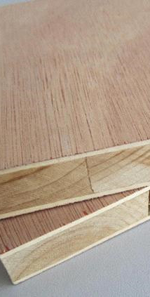
blockboard
Blockboard consists of a core of wooden strips sandwiched between two layers of plywood.
It is used to make doors, tables, shelves, partition walls and panelling, amongst other things.

Slide 19
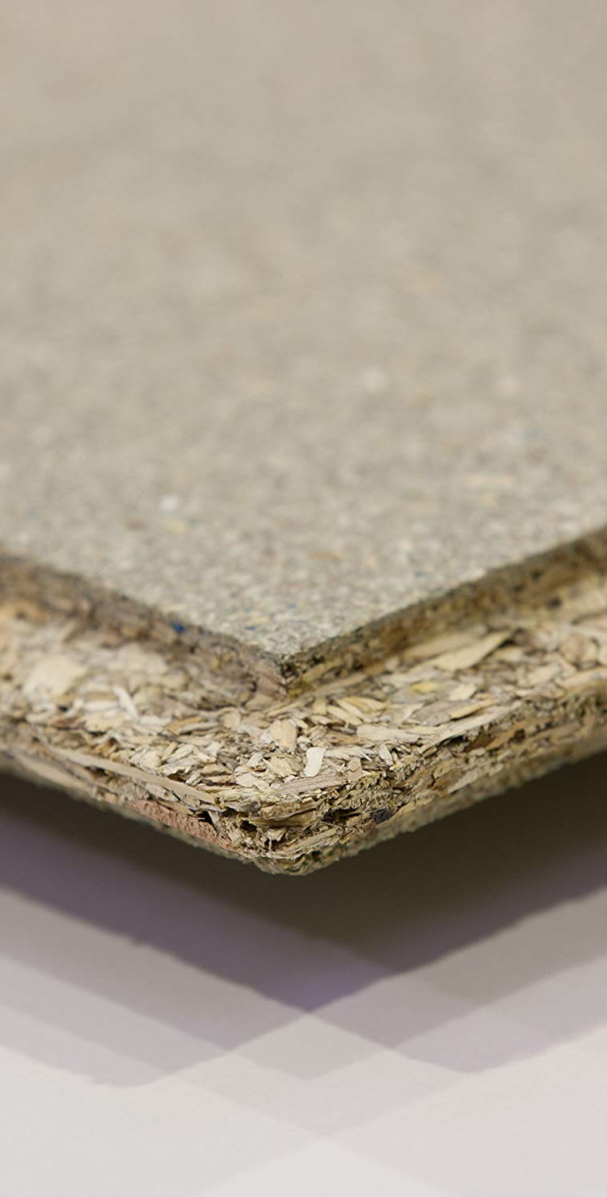
chipboard
Chipboard is sometimes referred to as particle board or low-density fibreboard.
It is manufactured by mixing small wood particles with epoxy resin, which are pressed together under intense heat and pressure to produce a rigid board, typically with a smooth surface.
Chipboard is commonly used for floors, furniture and kitchen worktops etc.

Slide 20
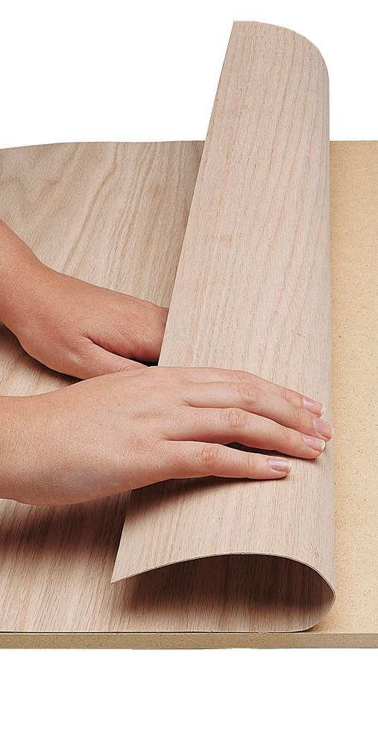
veneer
A veneer is a thinly cut layer of fine grain wood placed on top of a coarser piece of wood.
For example:
It is used to give the appearance of an expensive hardwood wood over, for example, a manufactured board or cheaper softwood.

Slide 21
Marking out tools
Before you start making anything in the workshop, you will need to mark out any wood working joints and waste wood onto your wood.
We use many different marking out tools to do this...

Slide 22
Steel rule
For measuring sizes on wood, metal and plastic.
The “0” of the steel rule starts right at the edge.
Sizes are in mm.

Slide 23
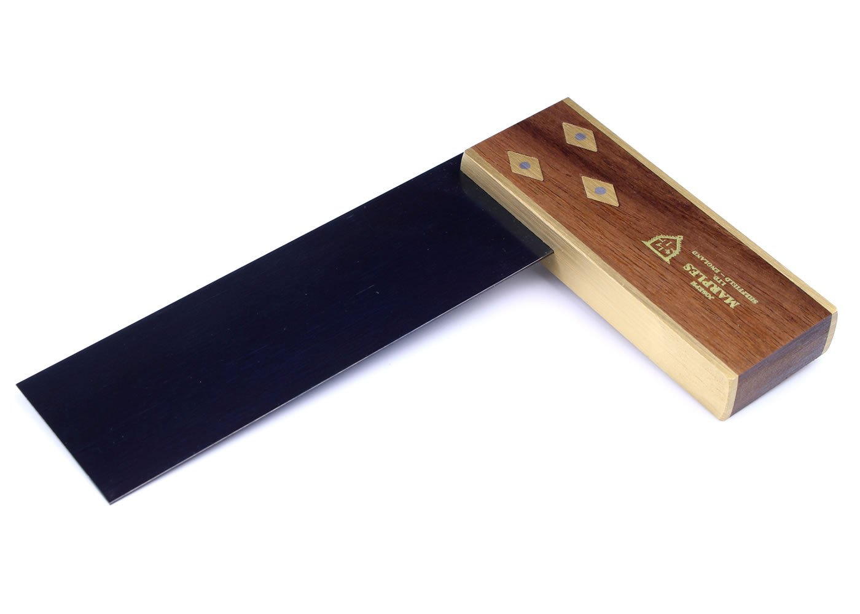
Try Square
For marking lines at right angles (90 degrees) to an edge of a piece of wood.
Always ensure the brass section is flush against the edge of the wood to ensure a perfect right angle.

Slide 24
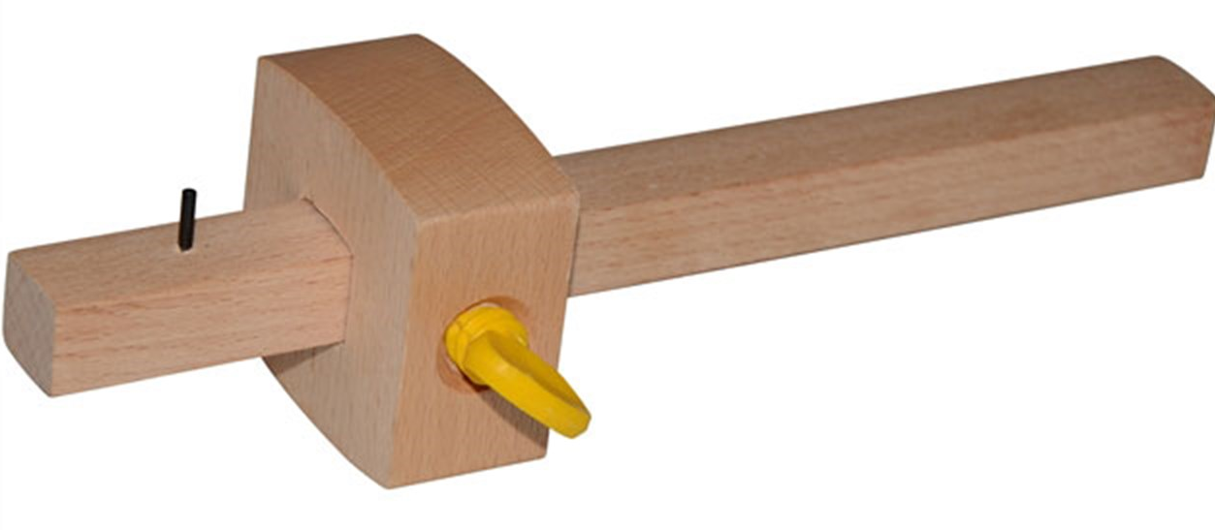
Marking gauge
For marking lines parallel to an edge of a piece of wood.
Stock
Spur
Stem
Thumb Screw

Slide 25
Mortise gauge
For marking out the width of a mortise hole for a mortis and tenon joint.
Thumbscrew
Stock
Adjustable Spur
Fixed Spur
Adjustment Screw - Adjusts width of the mortise joint.
Stem

Slide 26
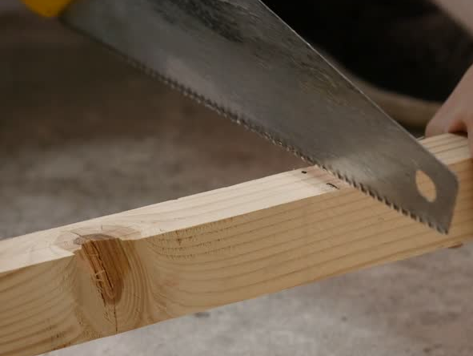
Cutting and shaping tools
Once you have finished marking out your job it is time to think about what tools you will need to cut and shape your work.
It is important to note that there are two categories of Saw: Rip Saws and Cross-cut Saws.
Rip Saws are used for cutting along the grain.
Cross-cut saws are used for cutting across the grain.

Slide 27
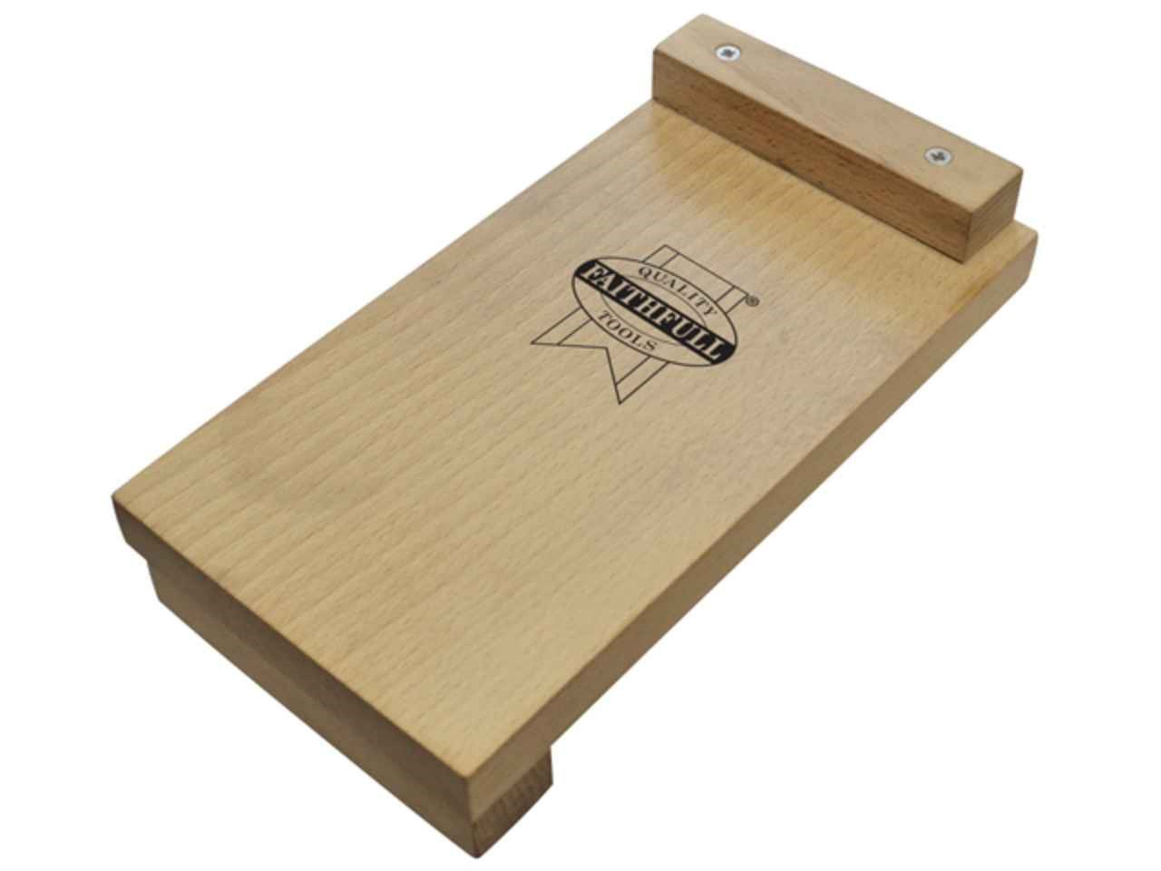
Bench hook/ sawing board
A bench hook is an aid to crosscutting small pieces of wood on the bench.
As well as helping you to hold the wood in place, it also supports the wood - particularly the small piece that is about to fall off when you've finished cutting.

Slide 28
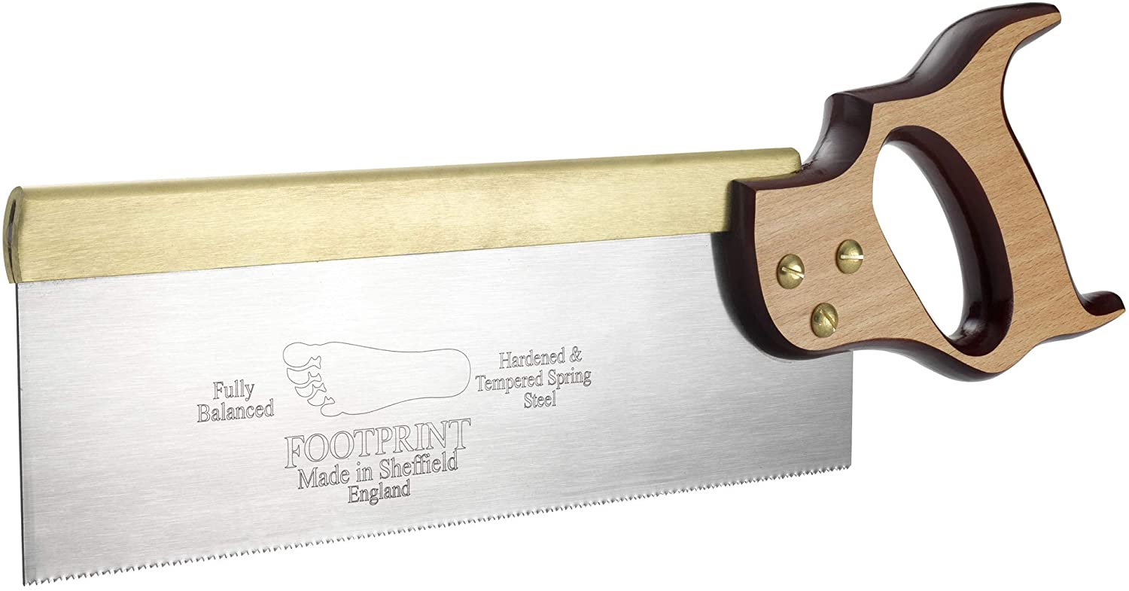
Tenon saw
Mainly used for cutting out joints in wood. This saw cuts very straight because the blade is very rigid (stiff) due to brass back at the top of the saw. (Cross-Cut Saw)

Slide 29
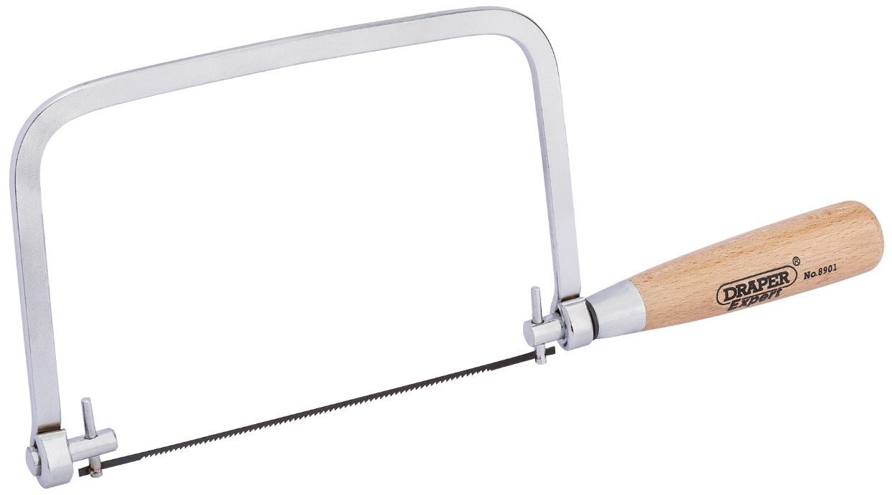
coping saw
A thin saw used for making curved cuts.
The blade can be set to almost any angle and is very flexible but can break easily so care and attention must be taken.

Slide 30
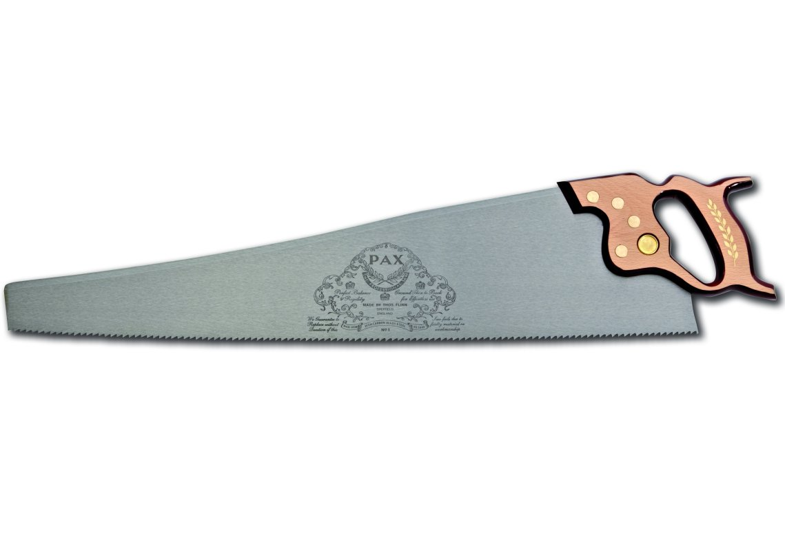
panel saw
Mainly used for making straight cuts in large pieces of timber.

Slide 31
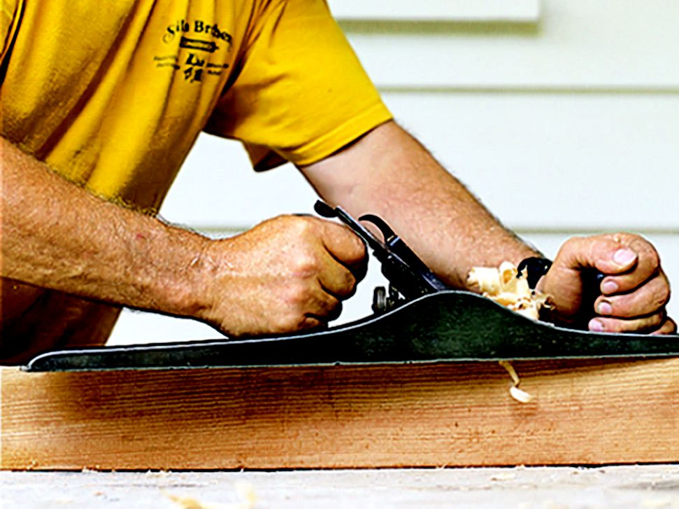
planes
Planes are used to flatten or reduce the thickness of timber. They can also be used to smooth the surface.
Plane Safety
Always ensure that the blade is set correctly to ensure that there is no risk of accident or damage to your wood/plane. Always place your plane side up on the work bench to ensure that the blade does not get damaged.

Slide 32
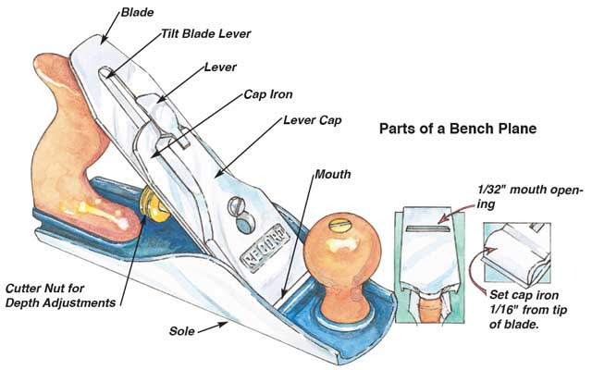
Smoothing & jack plane
Although both Jack and smoothing planes look similar they are used for different jobs:
Jack planes are used to make long edges straight and square and are longer than smoothing planes.
Smoothing Planes are used to make surfaces smooth.

Slide 33
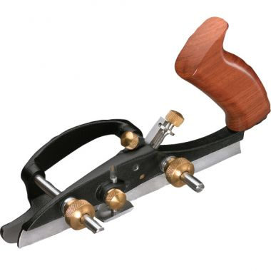
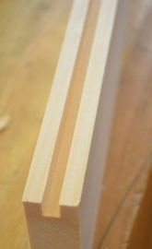
Plough plane
Used for cutting grooves on the inside face of a piece of wood.
The depth of the cut can be set by adjusting the blade and the width from the edge of the wood can be adjusted by setting the fence of the plane.
Example cut:

Slide 34
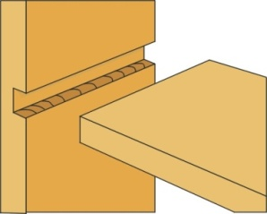
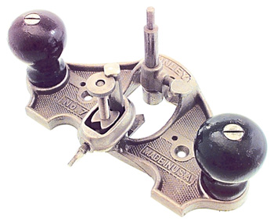
router plane
Example of cut made
Used for cutting or
tidying joints such as a housing joint.
Blade
Blade
Adjustment
Screw

Slide 35
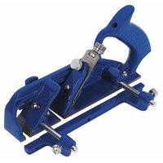
rebate plane
Used for cutting grooves on an edge of a piece of wood.
Example of cut made

Slide 36
bullnose plane
The shoulder plane has a blade flush with the edges of the plane, allowing trimming right up to the edge of a workpiece. Is also used to plane the end grain of wood due to the shallower blade angle.
Blade Adjustment Screw
Blade

Slide 37
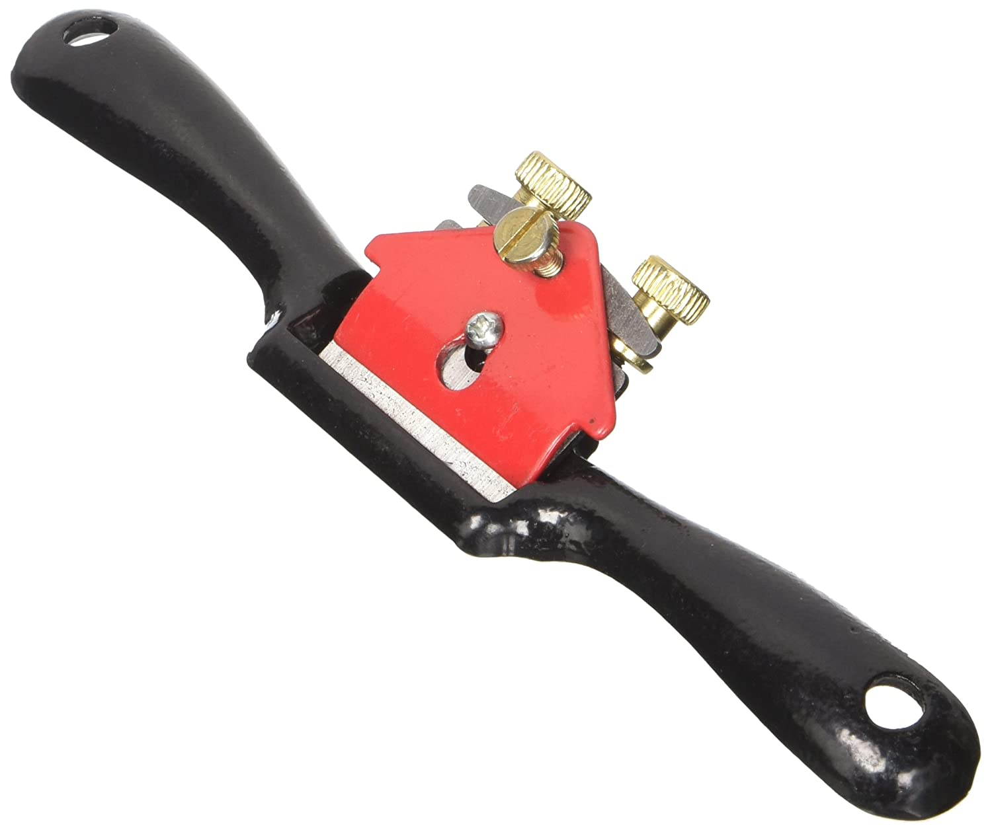
spokeshave plane
Blade Adjustment Screw
A spokeshave is a tool used to shape and smooth wooden rods and shafts – often used to make wheel spokes (not so much now, as there is not much demand for wooden wheel spokes), chair legs etc – also used to shape curves etc.
Blade

Slide 38
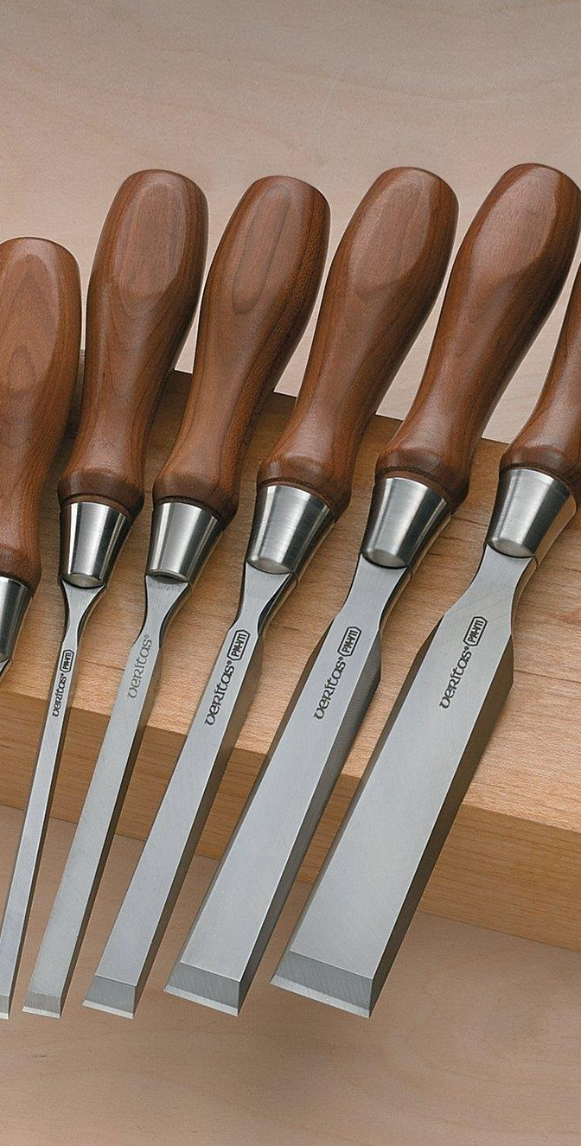
chisels
Chisels consist of a blade and a handle, used to accurately cut and shape wood.
The handle on a chisel is normally made from Ash, which is a very strong hardwood, or polycarbonate plastic so that it will offer resistance from splitting when being hit with the mallet. Wooden chisels will always have some type of ferrule that helps stop the wood from splitting this is normally a metal ring on one or both ends of the chisel’s handle.

Slide 39
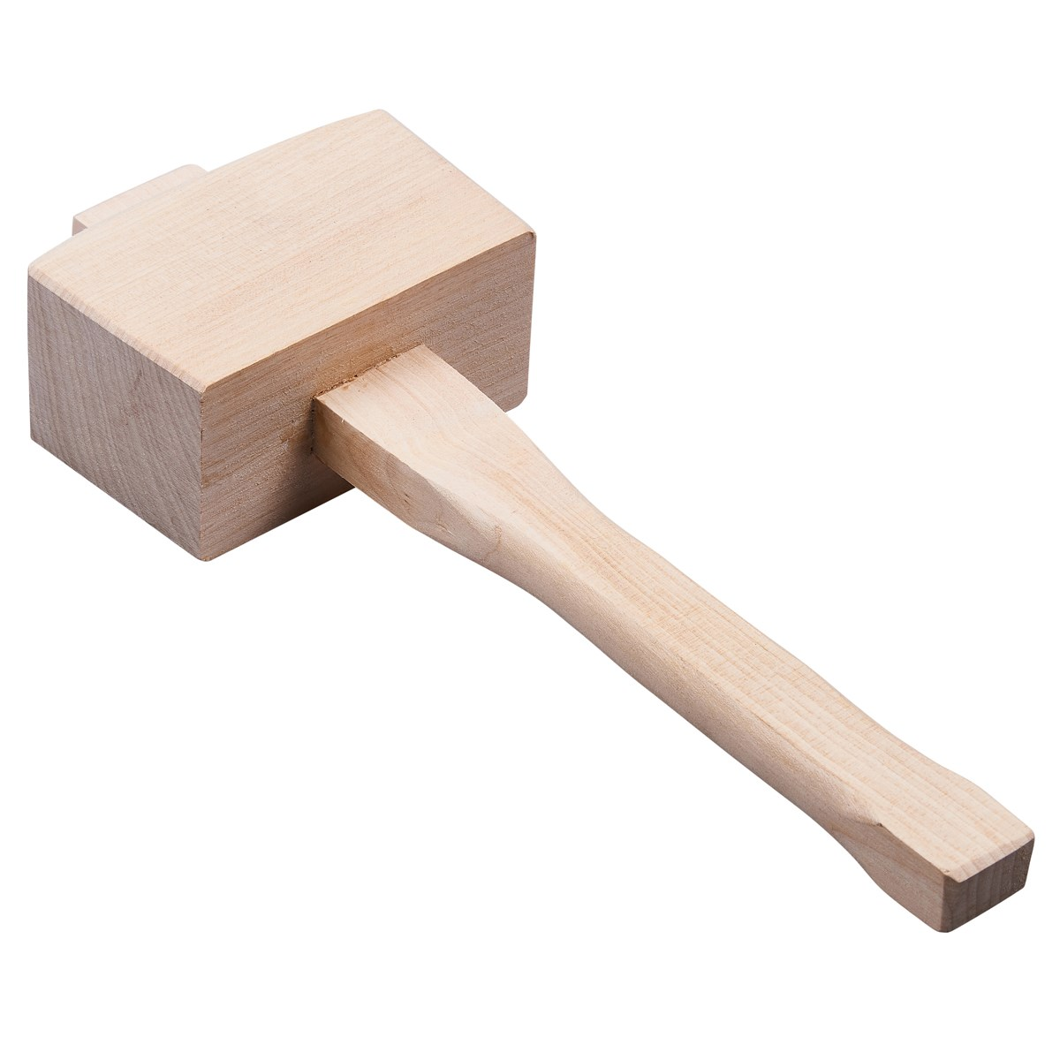
beech/wooden mallet
This is not a chisel but it is used along with chisels. The wooden mallet is used for hitting the handle of a chisel and driving it through a piece of wood to cut out waste wood.

Slide 40
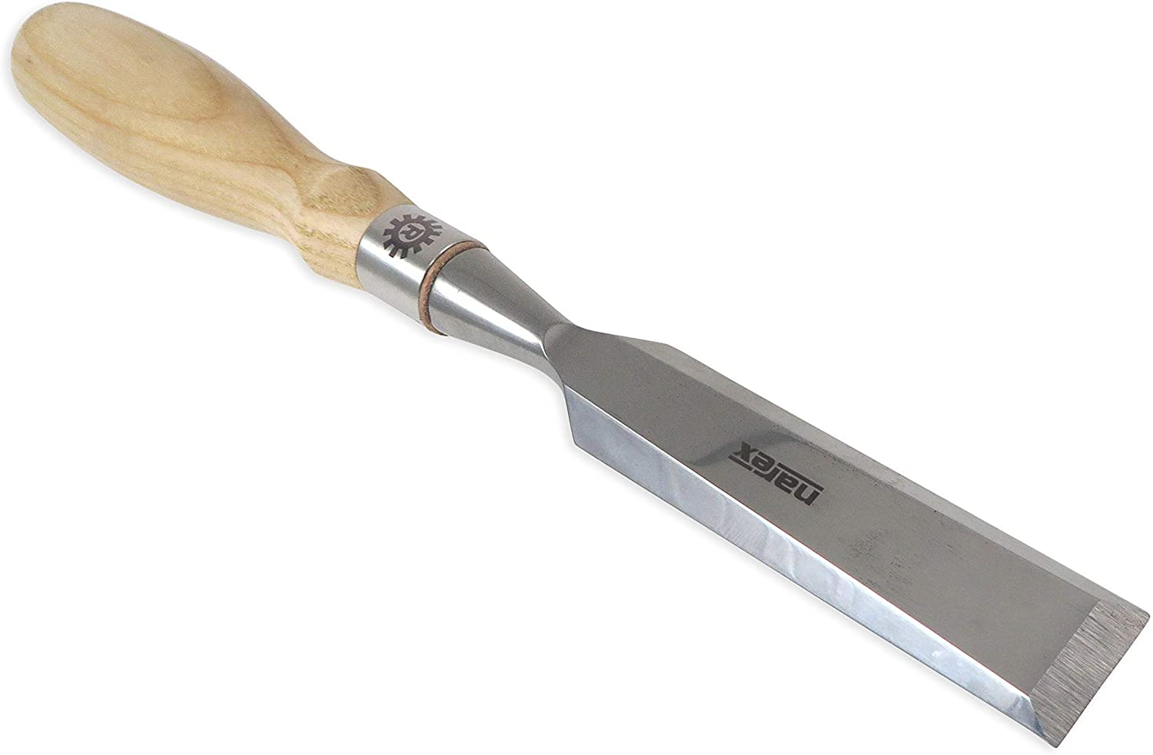
Bevel-edged chisel
The blade is sloped at the edges. This chisel is normally used for pairing wood or cleaning/tidying up joints.
Due to the blades having sloped edges it makes them easy to push into corners. They are often used for finishing dovetail joints.
End view of a bevel-edge chisel in use.

Slide 41
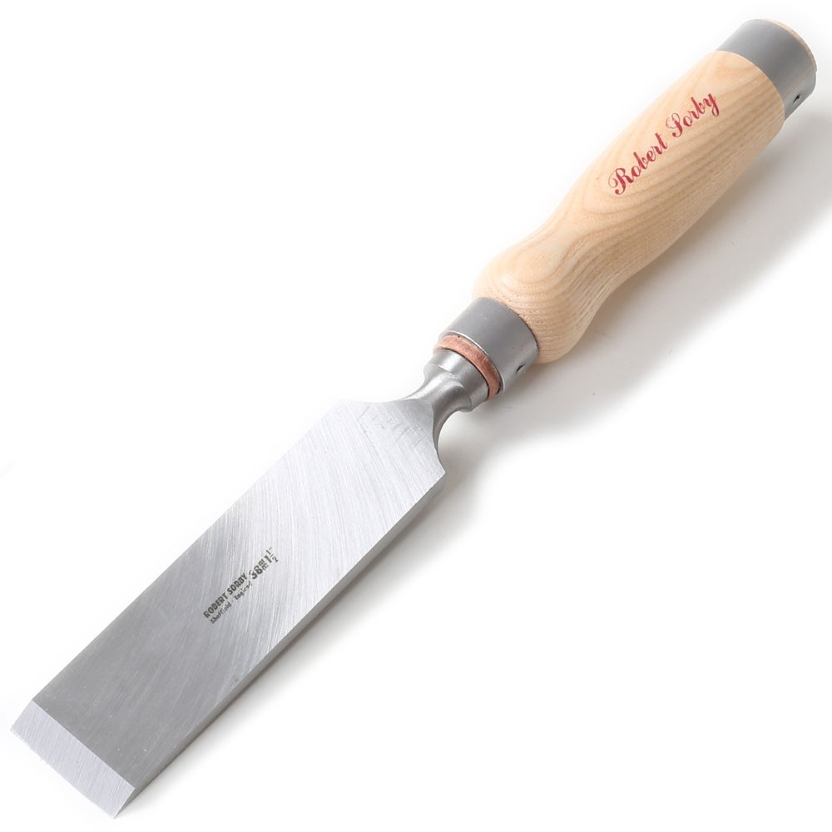
firmer chisel
Firmer chisels have straight sides which means that they are stronger and can be used for tougher/ heavier work.
End view of a firmer chisel in use.

Slide 42
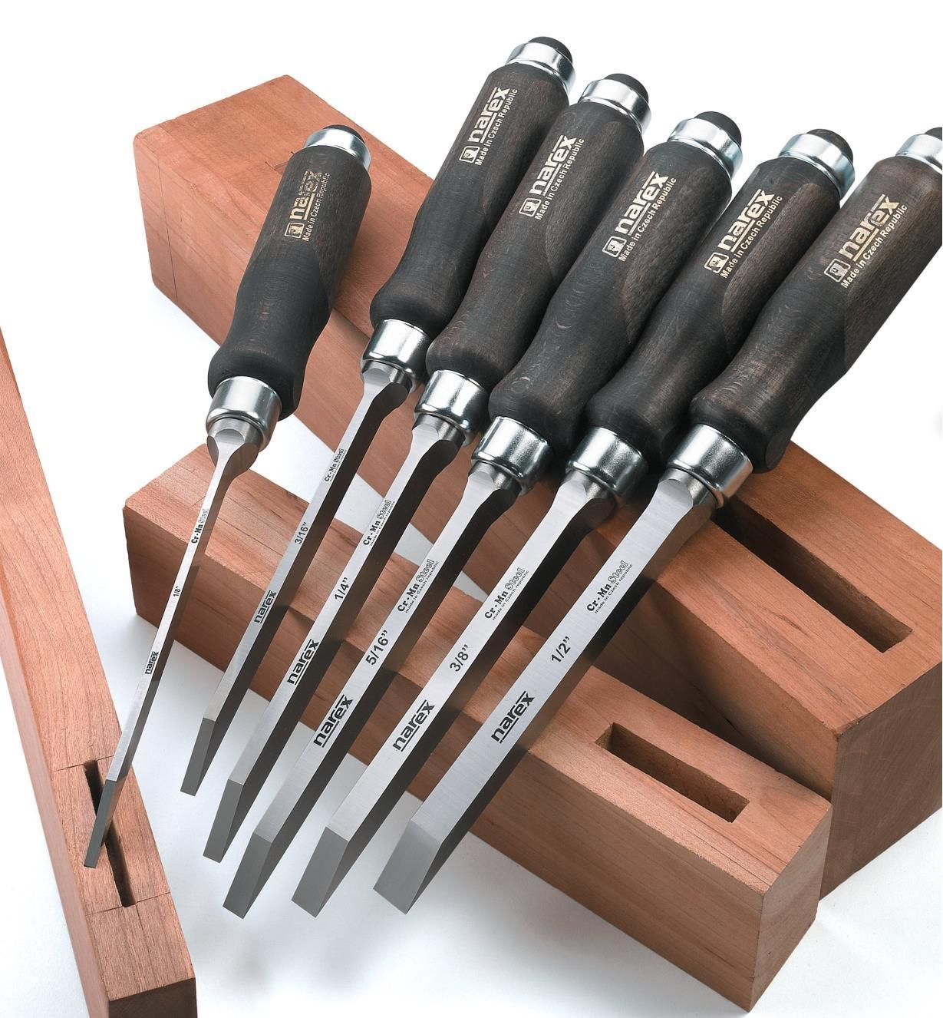
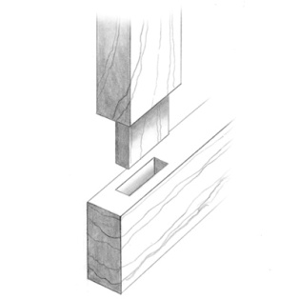
mortise chisel
Used for cutting the mortise (hole) in a
mortise & tenon joint.
Mortise hole
Mortise hole

Slide 43
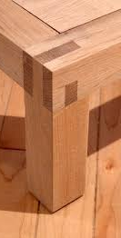
Timber joints
The majority of joints used in woodcraft have been designed specifically to attain the maximum possible strength in the model they are holding together.
The type of joint selected will depend on what is being constructed i.e. what forces are going to be exerted upon the artefact.
The selection is also dictated by the final appearance. i.e. in furniture manufacture it is normally important to hide the joint, as a piece of furniture which has a strong joint construction but if the joints are showing it will not be very pleasing to look at and ultimately potential customers would most likely avoid buying such furniture.

Slide 44
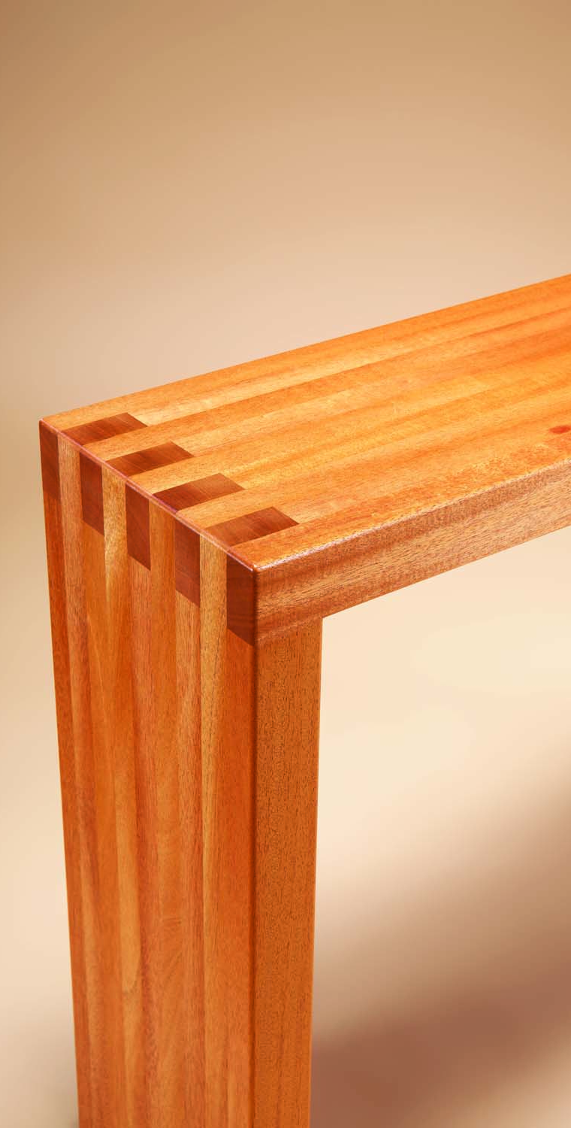
Wood joints
You will be shown an image of a wood joint.
Can you name the type of joint?
Some of these you have already made, for example:
The sides of the spice rack in S1.
The base of the mug tree in S2.

Slide 45
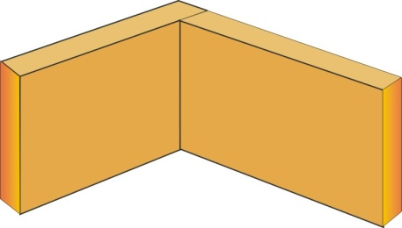
Butt joint
Butt joints are the quickest and simplest to make but are not very strong.
They generally need dovetail nailing to increase the overall strength of the joint.

Slide 46
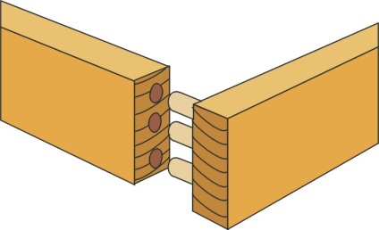
Dowelled joint
These joints are both neat and strong.
The holes must be lined up exactly but this can be done using a dowelling jig.
The dowel will have a groove in the length so as to allow excess glue to escape.

Slide 47
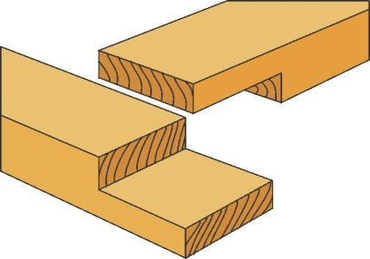
Corner halving joint
This joint is stronger than the butt joint and is also simple to make, but still needs strengthening with screws or dowels.

Slide 48
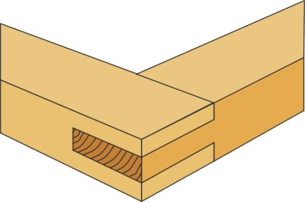
Corner bridle joint
This joint is strong and fairly easy to make. They can be strengthened by dowels.

Slide 49
Through mortise and tenon joint
The mortise & tenon joint is the strongest tee joint and can be further strengthened by wedging or dowelling.

Slide 50
Haunched mortise and tenon joint
This joint is used where the rail of a table will join into the top leg of the table. This could be regarded as a hidden joint.
Haunch

Slide 51
Dovetail joint
This type of joint is very strong and can be only pulled apart in one direction. It is mainly used to construct drawers.

Slide 52
Through housing joint
These joints are simple to make and are suitable where the two parts being joined together are the same width.

Slide 53
Stopped housing joint
These are harder to make, but are neater because the joint does not show on the front edge.

Slide 54
Flat pack furniture
Benefits to the Customer
Cheaper than softwood and hardwoods
Easier to move
Tends to be lighter
Furniture needs put together by the consumer
Ease of transportation in a car
Benefits to the manufacturer:
They do not need to assemble it
They can store more in the same space that assembled furniture would take up
Ease of transportation of large numbers

Slide 55
Knock down fittings
Knock-down fittings are joints that can be put together easily.
Normally people only need a screw driver, a drill, a mallet/hammer or other basic tools to put them together.
They are temporary joints although many are used permanently to join together items such as cabinets and other pieces of furniture that are purchased in a flat pack.
Common Knock down fittings are: Plastic or wooden corner blocks, Cam lock fittings & Scan fittings

Slide 56
Plastic corner block
The corner block is pressed against the two pieces of material
Screws are used to fix the block into position. This type of joint is used to fit modern cabinets such as those found in a kitchen. It is a relatively strong joint and it has the advantage that it can be dismantled using a screwdriver.

Slide 57
wooden corner block
A piece of material such as pine can be drilled and screws can be passed through these holes.
This gives a cheap and effective knock-down joint. The screws are normally countersunk into the knock-down fitting.

Slide 58
Cam lock fittings
The disk fits into a recess in the first side of the cabinet. It rotates by inserting a screwdriver into the slot in its side. The shaft is screwed into the second side of the cabinet.
The collar of the shaft is passed through the hole in the second slot in the disk. When the disk rotates the shaft is locked in position. This keeps both sides of the cabinet locked together.

Slide 59
Scan fittings
These are strong enough to be either permanent or temporary joints. The cylinder is inserted into the first side of a cabinet in a pre-drilled hole.
The screw is then pushed through the hole in the second side until it meets the cylinder.
It can then be tightened with a screw driver until both sides of the cabinet pull together.

Slide 60
Manufactured boards-examples
Hardwoods
Beech
Elm
Oak
Ash
Mahogany
Obeche
Balsa
Softwoods
Scots Pine
Western Red
Cedar
Parana Pine
Spruce
Manufactured Boards
Plywood
Blockwood (core wood edge-to-edge between 2 layers of plywood)
Chipboard (low density fibreboard)
Hardboard (high density fibreboard)
MDF (medium density fibreboard)

